Slide 1
Understanding Social Networks
By Charles Kadushin – 1916 – 2014
Oxford University Press
Social Network Theory Course
Dr. Mohammad Reza Amin Naseri
Student: Mohammad Heydari
MSC in Networked System Engineering

Slide 2
Topics
___________________________________________________
Connections
Propinquity
Homophily
Individual Level Homophily
Homophily and Collectives
Dyads and Mutuality

Slide 3
Propinquity effect Individuals are more likely to be friends if they are Geographically Close (Fled and Carter, 1998) A Pioneering study of the propinquity effect on new housing project for World War II veterans (Festinger, Schacter and Back, 1950) Person Who lived near to one another were more likely to become friends. Person in corner housing units were more likely to be socially isolated than persons in units that lay between other units(ibid)

Slide 4
Importance of Location Study of networks in USA of people who serve together on several different corporate boards of director(Interlocking directors) Interlocks are concentrated in firms headquartered in same local (Kono et al 1998)

Slide 5
Propinquity It can also be defined as being in a same place at the same time. Common interests (music), Economists tend to define propinquity in terms of cost of transportation rather than actual number of miles between nodes or sheer border crossings (خطوط مرزی) when tariff(تعرفه) is not an issue.

Slide 6
Propinquity Studies of elites show that, persons are more likely to have a connection if they went to the same prep school at the same time (Domhoff, 1967). Of course, these individuals may merely share an “old school tie. (they went to the same school but at a different times), in which case we are talking about homophily, a different kind of Propinquity.

Slide 7
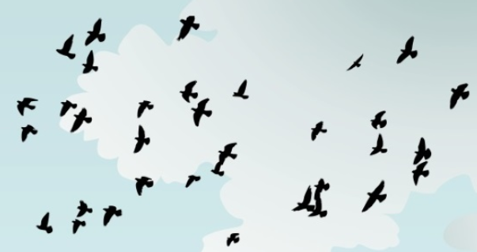
Homophily (from the Greek, “love of the same”) a Concept by Lazarsfeld and Marton a folk proposition: “birds of a feather flocks together.” In Persian: “کبوتر با کبوتر، باز با باز” if two people have characteristics that match in a proportion greater than expected, then they are likely to be connected. (Verburgge, 1977) the converse is true: if two people are connected then they are more likely to have common characteristics or attributes.

Slide 8
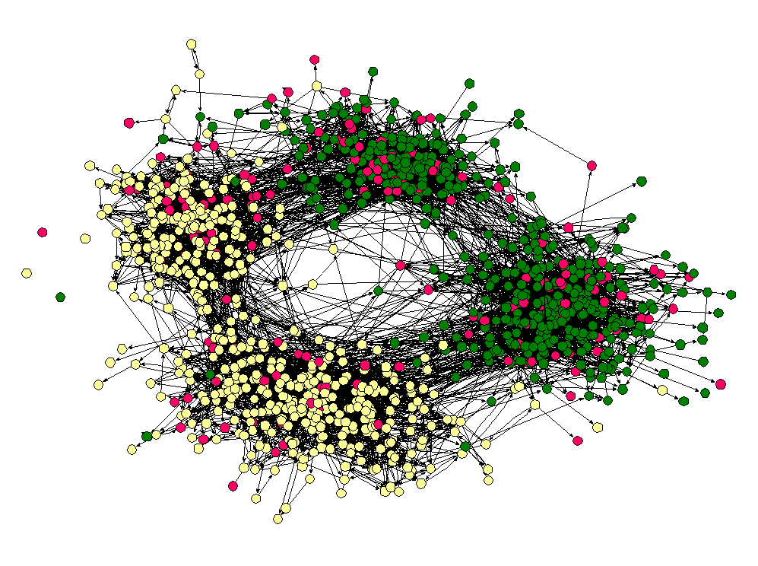
Individual-level Homophily At this level, persons are more likely to have connections, friendship or association, if they have common attributes.(Lazarsfeld, Marton)

Slide 9
Distinguish between status-homophily (Lazarsfed, Matron) which can be ascribed (e.g., age, race(نژاد)) or acquired (e.g., marital status, education, occupation) and value-homophily (e.g. ,attitude, stereotypes), which also has been termed to homogeneity. Common attitudes can be based on patterns of relationships (Erickson, 1988)

Slide 10
Homophily in Social Networks Which attributes is a salient candidate for homophily in Social Network? e.g., race: skin color:: related to the children choice to find friend in a class!

Slide 11
Two kind of cause of Homophily! First. Common norms or values may bring nodes with common attributes together or the reverse Common attributes and contacts may lead to common norms both true for individuals and collectivities E.g., Study of adolescent girls! Same clique: similar scores on various measure of behavior:: eating, alcohol but we don’t know whether they hang around together because they share similar habits or they have become similar to each other while hanging around.

Slide 12
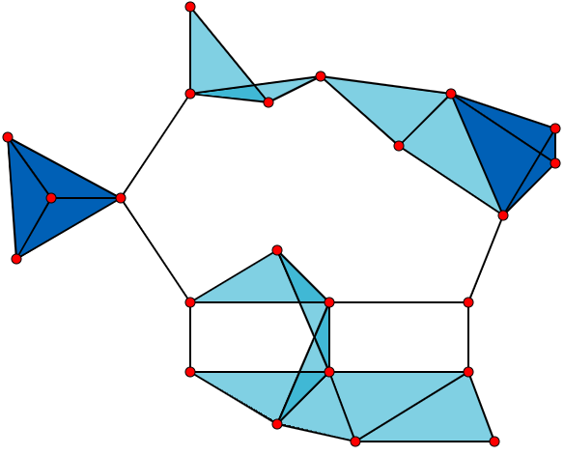
Clique A clique, C, in an undirected graph G = (V, E) is a subset of the vertices, C ⊆ V, such that every two distinct vertices are adjacent. the word "clique" is used to describe a group of 2 to 12 (averaging 5 or 6) who interact with each other more regularly and intensely than others in the same settings. Salkind, Neil (2008-01-01). "Cliques". Encyclopedia of educational psychology. Sage Publications.

Slide 13

Homophily as a Process! Chicken-and-egg situation always create difficulties. if people hang out together they tend to have the same attitudes. If they have the same attitudes they tend to hang out together (Erickson)

Slide 14
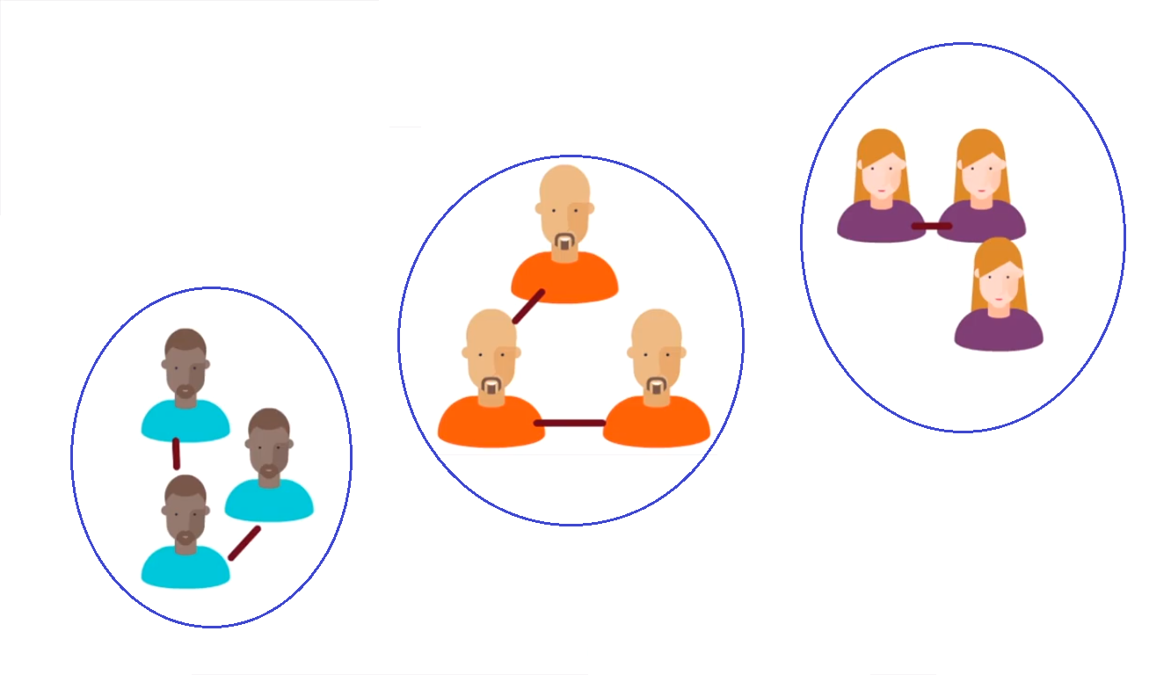
Two kind of cause of Homophily Second. Structural Location. Two nodes may have the same attributes, because both operates in the same arena, and again vice versa. While similar pairs tends to form a relationship, the availability of similar attributes is a function of social structure. I am more likely to find people interested in solving mathematical problems in physics class than in a class on English literature. But people drawn to mathematics are more likely to choose a physic class that an English class.

Slide 15
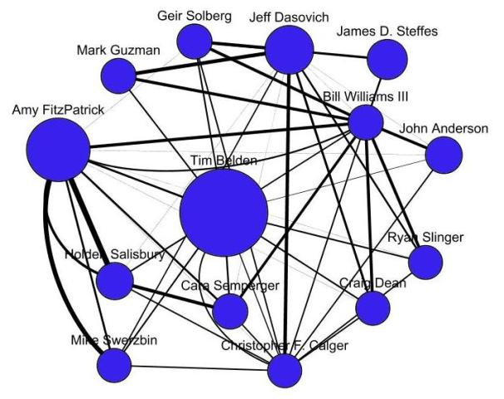
Case Study Studying email interaction over a year of 30000 Students and Staff Kossinetes and Watts(2009) Result: individual preferences and for like persons and common social location both produced Homophily.

Slide 16
In sum: if people flock together four processes are involved: 1. the same kinds of people come together 2. people influence one another and in the process become alike (شبیه هم شوند) 3. people can end up in the same place (be In the same place together) 4. and once they are in the same place, the very place influences them to become alike. (مکان بر مردم تاثیر می گذارد تا مثل هم شوند.)

Slide 17

Homophily and Collectivities (اجتماعات) At organizational level! Ford, General Motors having common characteristics: they are automobile manufacturers and are geographically adjacent. But these are not necessarily led to a tie. E.g., Ford does not sell cars to General Motors. On the other hand, when engineers and managers move from one company to another, a tie develops between automobile companies. Similarly, software firms in Silicon Valley cultivate tie to another through exchanging personnel.

Slide 18
External Economies | also called Outsourcing in Software Engineering-based Projects “the economies that a firm can obtain through the use of facilities or services external to itself” (Hoover and Vernon 1962) advantages: readily available service. lower transaction costs.

Slide 19
Dyads and Mutuality (زوج ها و اشترکات طرفین) 1. relations are reciprocal (دوطرفه) 2. mutuality is strongly affected by the social and cultural structure within which dyads are embedded. (همبستگی به شدت تحت تأثیر ساختار اجتماعی و فرهنگی قرار دارد که در زوج ها تعبیه شده اند.) Mutuality is strong factor in the formation of children's friendships (Schaefer, 2010)

